Slide 1
UCSHIP = health insurance
54% of all UCSD students are enrolled in UCSHIP health insurance, 46% of the students opt out of the offering by filing a timely health fee waiver using their own insurance coverage. Currently, we have 5,936 (28%) graduates on UC SHIP. The #1 insurance used to waive for grads is Kaiser.
The UCSHIP plan is administered by Anthem Blue Cross, PPO. The plan is specific to UC and built by students. The plan is not sold to the public. Student Health is the Primary Care Clinic for these members.
The plan pays benefits for primary care, prescriptions, outpatient and inpatient services as well as mental health, unlimitedly. UCSHIP also provides a supplemental coverage for dental and vision. There are out of pocket expenses like copays, coinsurance, and deductibles depending on who students use for care. The UC Family is their most cost effective option for care, but students also have access to the Anthem Blue Cross network of contracted providers, and they will be reimbursed at 60% for out of network care. The plan provides national and global coverage.
Student of UC may use other UC campus Student Health clinics in California and receive the same benefits.

Slide 2
UCSHIP Three Tiers of Coverage
UC Family
Anthem Network
Out of Network
Using UC Providers and Facilities will save the student some out of pocket expenses. There isn’t a deductible under this tier and we have 3 acute UC hospitals in the surrounding neighborhood.
Using the second tier of benefits, means you are not going to a UC provider or facility, but you are seeking care at a Anthem Blue Cross, PPO contracted provider. You can find providers by calling Anthem at 1-866-940-8306 or using Find a Provider on the Anthem.com website.
This requires a $500 deductible.
This means you are using a provider that doesn’t work for UC and doesn’t hold contracts with Anthem Blue Cross, PPO. This is the highest out of pocket experience under any insurance. This requires a $1000 deductible be satisfied before Anthem will pay any claims. After the deductible is met, you will need to submit claims to Anthem and they will be paid at 60% of billed charges, leaving you with an additional 40% to pay.
*A prior referral is needed for any care received outside of Student Health, except: Urgent Care, ER, dental, and vision exams.

Slide 3
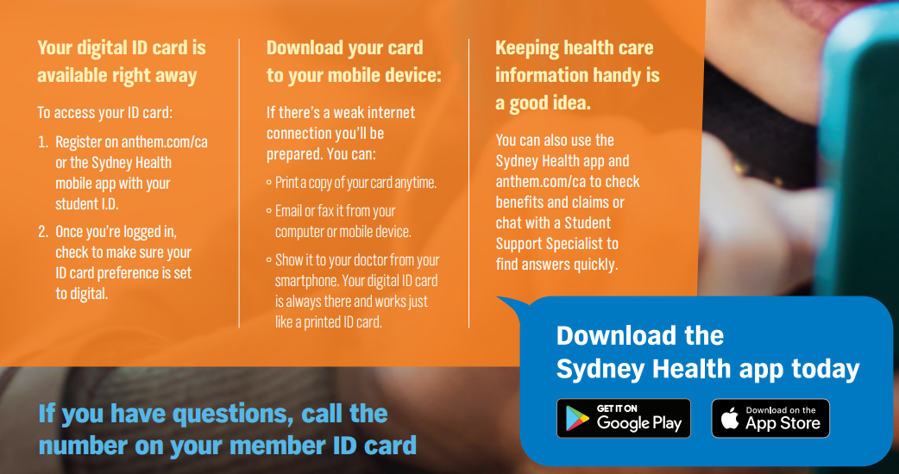
Digital insurance cards
Notes:
To get a copy of your insurance card, please download the Sydney APP on your phone or mobile device.
This app will provide you with a copy of the front and back our your insurance card and will allow you to view claims processed under your subscriber ID.
The App also allows you to look up providers and facilities contracted with Anthem Blue Cross.
We are ecologically minded and no longer mail out hard copies of the insurance card.

Slide 5
Mental Health Options
UC SHIP Mental Health Options
Contact CAPS 858-534-3755 or Student Health 858-534-3300 to request an appointment or request a referral for an external provider.
Students may schedule through MyStudentChart.
UCSD College Mental Health is a $5 copay per visit. Referrals are valid for one year or 52 visits and may be used by different providers.
Referrals for Anthem Blue Cross providers are a $10 copay per visit and referrals are valid for one year or 52 visits and may be used by different providers.
Live Health Online for mental health, students access the website and follow the instructions: https://livehealthonline.com/
For Lyra providers, students would call CAPS to set that up 858-534-3755.

Slide 6
Live Events
Are you turning 26 and losing your health insurance?
Did you get married?
Enter into a domestic partnership?
Divorced?
Have a baby?
If you have had a life event and you need to enroll in UCSHIP, please take a look at our website:
Removing or Adding a dependent:
https://shwadmin.ucsd.edu/uc-ship/non-registered/index.html
For those turning 26 and/or losing insurance coverage:
https://shwadmin.ucsd.edu/_files/insurance/UCSHIP_ExcepToEnroll.pdf

